Slide 1
Homeostasis
Gas concentration

Slide 2
Breathing
All cells produce carbon dioxide as a product of respiration. This is removed via the lungs.
All cells require oxygen for respiration. This enters the body via the lungs.
Both gases are able to be transported via the circulatory system.

Slide 3
Control of breathing
The diaphragm and the intercostal muscles cause air to move in and out of the lungs.
The phrenic nerve stimulates contraction of the diaphragm.
The intercostal nerves stimulate contraction of the intercostal muscles.
These spinal nerves originate in the neck and thorax

Slide 4
Control of breathing
The respiratory center is located in the medulla oblongata.
It is comprised of the expiratory centre (controls breathing out) and the inspiratory centre (controls breathing in)
These two centres communicate with each other to coordinate breathing.

Slide 5
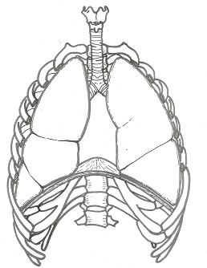
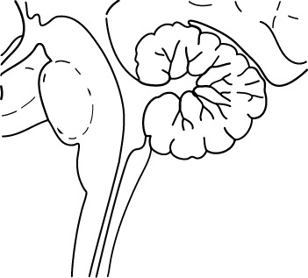
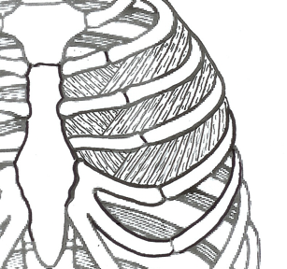
Control of normal breathing
Impulse to diaphragm & external intercostal muscles
INHALE
+
-
Inspiratory nucleus
Exspiratory nucleus
EXHALE
Medullary rhythmicity centre
Impulse to internal intercostal muscles

Slide 6

Carbon dioxide and pH
The amount of carbon dioxide in the blood effects the pH of the blood (acidity)
When carbon dioxide dissolves in the plasma it causes the pH to decrease (become more acidic).
This is because carbon dioxide reacts with water to form carbonic acid.
As a result the acidity of the blood is able to give an indication of the pH and carbon dioxide concentration.

Slide 7
Receptors – measuring gas concentration
Central Chemoreceptors in the medulla oblongata:
  detect carbon dioxide concentration and pH of the blood plasma and cerebrospinal fluid.
  May take a few minutes to respond and communicate but are responsible for the majority control of breathing rate.

Slide 8
Receptors – measuring gas concentration
Peripheral chemoreceptors: Aortic and carotid bodies:
  measure changes in the pH (hydrogen ion concentration), carbon dioxide and oxygen levels of blood plasma.
  Can respond quicker due to their location however, when responding to oxygen levels they are only responsible for a comparatively smaller increase in breathing rate. When responding to hydrogen ion levels (and CO₂) they are responsible for a comparatively larger increase in breathing rate.

Slide 9
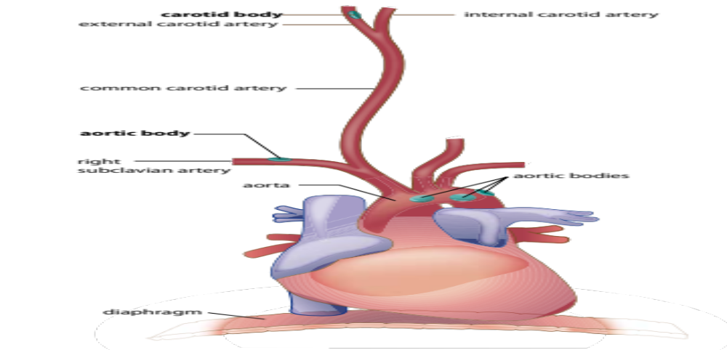
Receptors – measuring gas concentration

Slide 10
Carbon dioxide and breathing rate
A small change in carbon dioxide levels as measured by the chemoreceptors in the medulla oblongata can have a marked change in breathing (very sensitive to carbon dioxide levels).
For oxygen levels to effect breathing rate the change has to be quite significant (the body is not as sensitive to changing oxygen levels compared to carbon dioxide).

Slide 11
Negative feedback loop – High CO₂
Chemoreceptors:
  Medulla oblongata
  Aortic and Carotid bodies
High CO2
(= low pH or high H+)
or low O2
Stimulus
Receptor
Respiratory centre in medulla oblongata
Levels of CO2
& O2 return to normal
Control
centre
Feedback
Reflexes involving somatic nerves
Response
Effector
Increased rate and depth of breathing
Respiratory muscles (diaphragm and intercostal muscles)

Slide 12
Voluntary control of breathing
The cerbral cortex has connections via the descending tracts of the spinal cord that bypass the respiratory centre.
As a result we can consciously control breathing (necessary for speech) allowing us to hold our breath.
When holding your breath the respiratory centre will take over once the carbon dioxide levels become to high.

Slide 13
Hyperventilation
Involves rapid and deep breathing to provide more oxygen and remove more carbon dioxide then necessary.
This can occur due to severe physical or emotional stress. However it will correct itself as the chemoreceptors will not be stimulated and breathing will not be required until it returns to normal.

Slide 14
Hyperventilation
Can be done intentionally. A swimmer may do so because it will allow them to stay under water for longer without needing to breathe.
However as the breathing reflex responds to carbon dioxide, the person may require oxygen before carbon dioxide levels rise to the point were the body stimulates the breathing reflex.
This could result in lack of oxygen to the brain causing the person to fall unconscious and to drown.

